Slide 1

STEAM Sessions: Exploring Light

Slide 2

Exploring Light - Light and Shadows
Learners will
1. Work collaboratively paying attention to everyone's inputs.
2. Use problem solving to find the best method, using trial and error where appropriate.
3. Describe how light travels through different materials.
4. Show how different colours make up white light and how they can be broken down.
5. Research to understand more and how what you’ve learned can be used in the real world.
Notes:
Light and Shadows – The focus of this
Exploring how light travels, the colours of light and how they can be broken up by making a spectroscope, and combined using shadows and coloured lights.
Understanding how the colours of pixels combine on a screen, and how the colours of light are different to the colours of paint.

Slide 3
Bending Light
Refraction

Slide 4
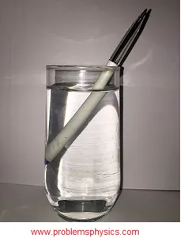
Refraction examples – change in direction of a ray of light
Notes:
Refraction examples – change in direction of a ray of light
What is happening here?
Things can look different under water. It looks like this pen is broken at an angle. Why?

Slide 5
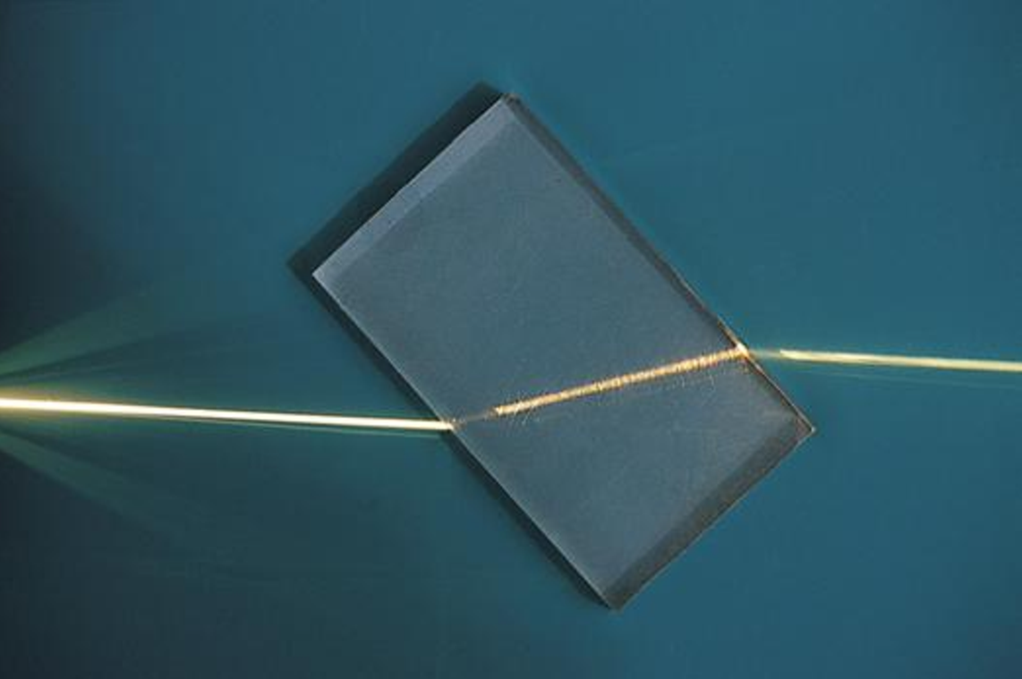
Notes:
Light travels at different speeds through different mediums, so it gets refracted – turns at an angle.
What happens if you shine the laser at different angles?
What if you shine it straight on? No refraction
Try this with a prism

Slide 6

Notes:
When a wave moves into a slower medium (like the Perspex block) the wavefronts get compressed. For the wavefronts to stay connected at the boundary the wave must change direction – so it bends or refracts

Slide 7


Slide 8
Notes:
Any more examples of refraction which you see in the world around you?
- images in water on a window (looks upside-down)
- heat haze
- mirage, such as on a road looks like there is a puddle when it's really hot out due to different densities in the hot and cooler air
- prism – Pink Floyd album cover (Dark Side of the Moon)
- rainbows!

Slide 9
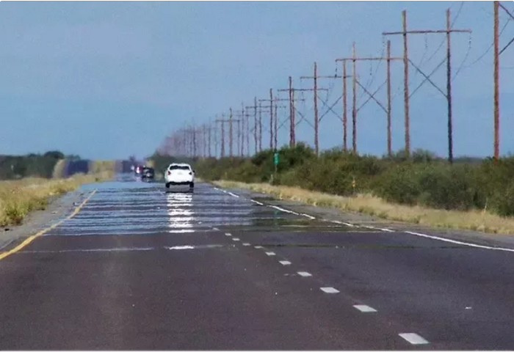
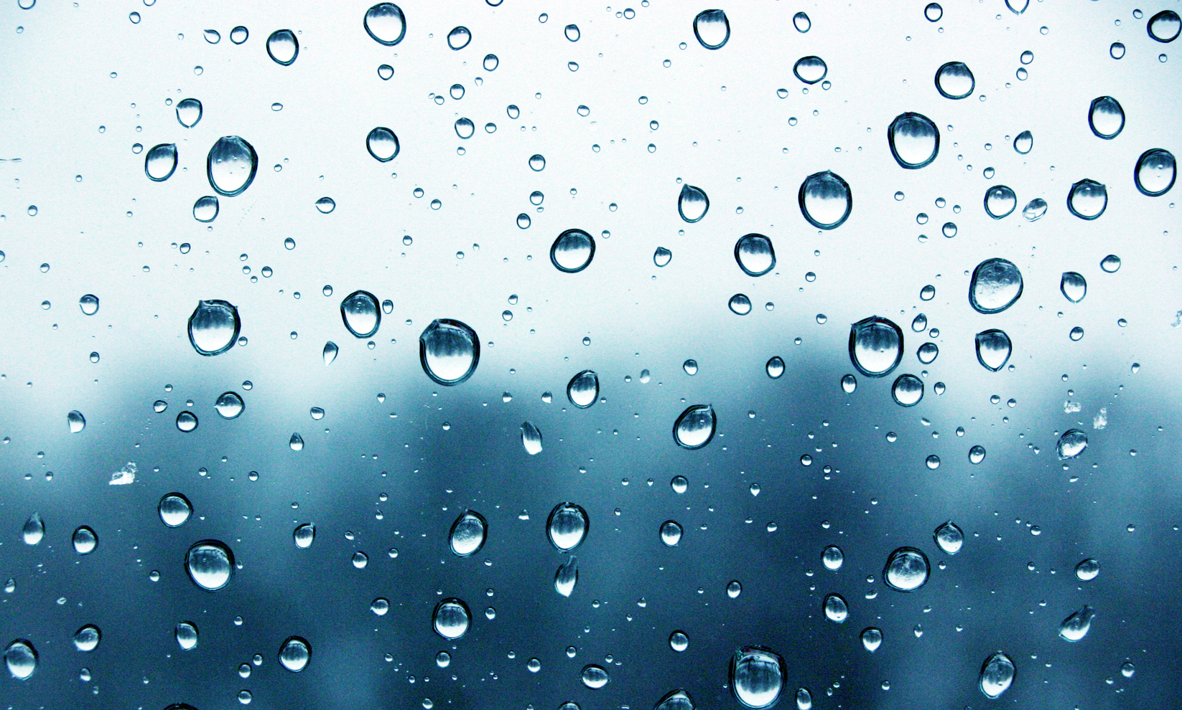
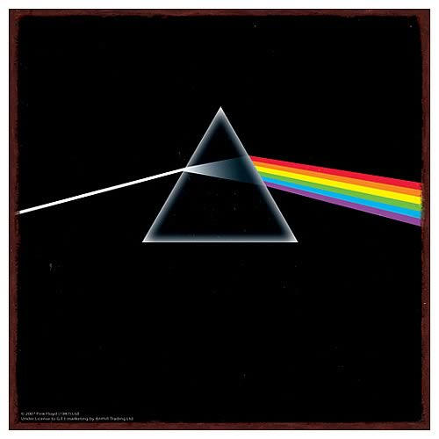
Notes:
Any more examples of refraction which you see in the world around you?
- images in water on a window (looks upside-down)
- heat haze
- mirage, such as on a road looks like there is a puddle when it's really hot out due to different densities in the hot and cooler air
- prism – Pink Floyd album cover (Dark Side of the Moon)
- rainbows!

Slide 10
Splitting Light
Dispersion

Slide 11
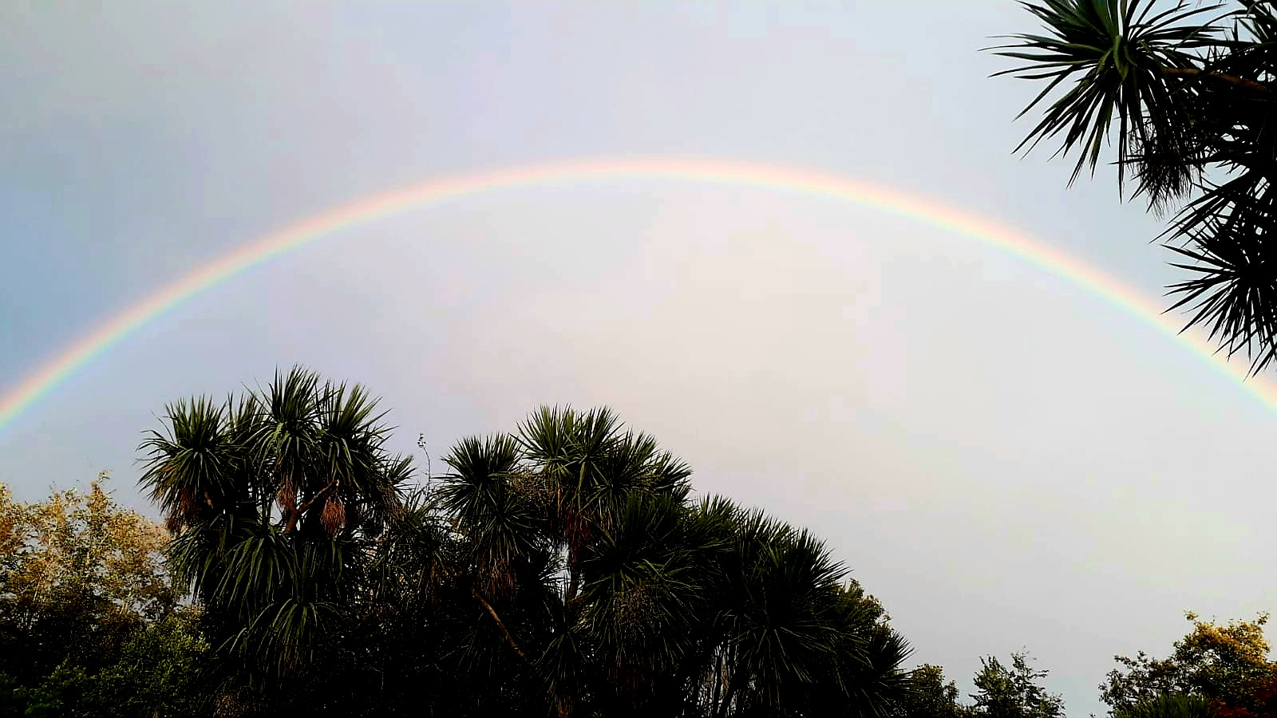
Notes:
We're going to make rainbows indoors – how?
What causes a rainbow?

Slide 12
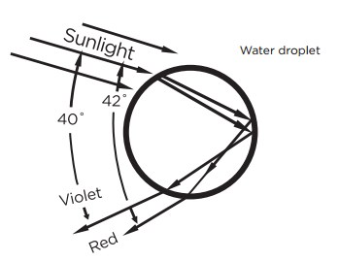
Notes:
Each droplet of water refracts the light similar to the prism.
Light goes from air (low density medium) to water (higher density medium) so it bends/refracts
Then light gets reflected inside the water droplet (total internal reflection)
Finally the light passed back out of the water into the air, from a dense to a lower density medium.
The different types/wavelengths of light refract/bend at different rates, so the white light gets split up into its different colours

Slide 13

Notes:
Each droplet of water refracts the light similar to the prism.
Light goes from air (low density medium) to water (higher density medium) so it bends/refracts
Then light gets reflected inside the water droplet (total internal reflection)
Finally the light passed back out of the water into the air, from a dense to a lower density medium.
The different types/wavelengths of light refract/bend at different rates, so the white light gets split up into its different colours

Slide 14
We’re going to investigate how light can be split up to form a rainbow by making a spectroscope.
Notes:
Spectroscope

Slide 15

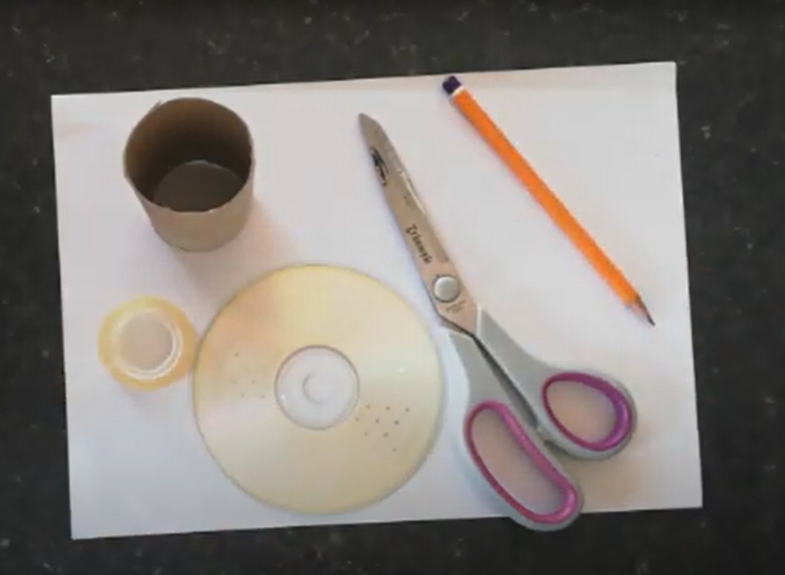
https://youtu.be/M79NmcjZtpk?t=53
Notes:
Spectroscope
Video https://youtu.be/M79NmcjZtpk?t=53

Slide 16
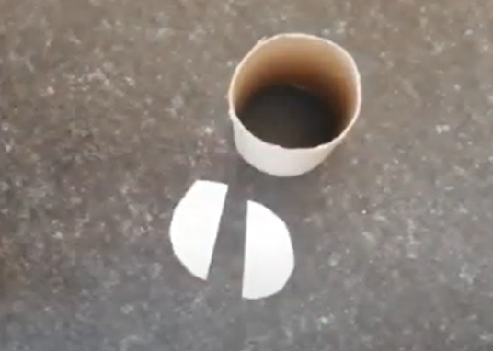
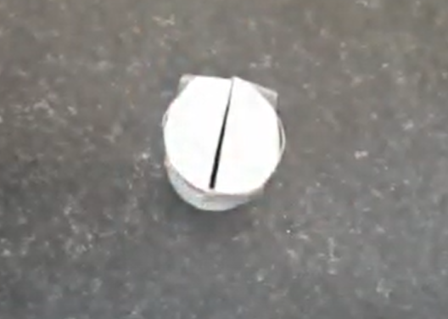

Slide 17
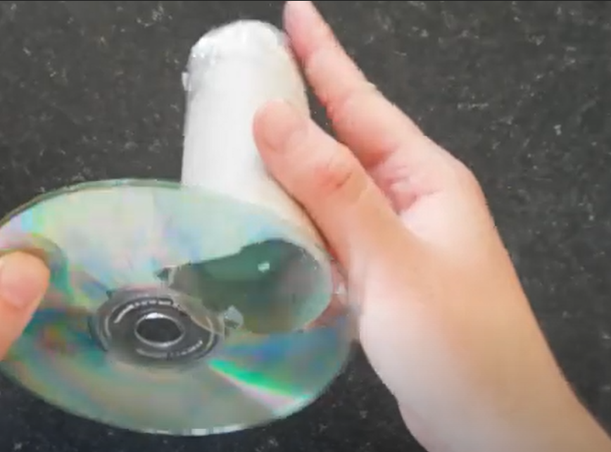

Slide 18
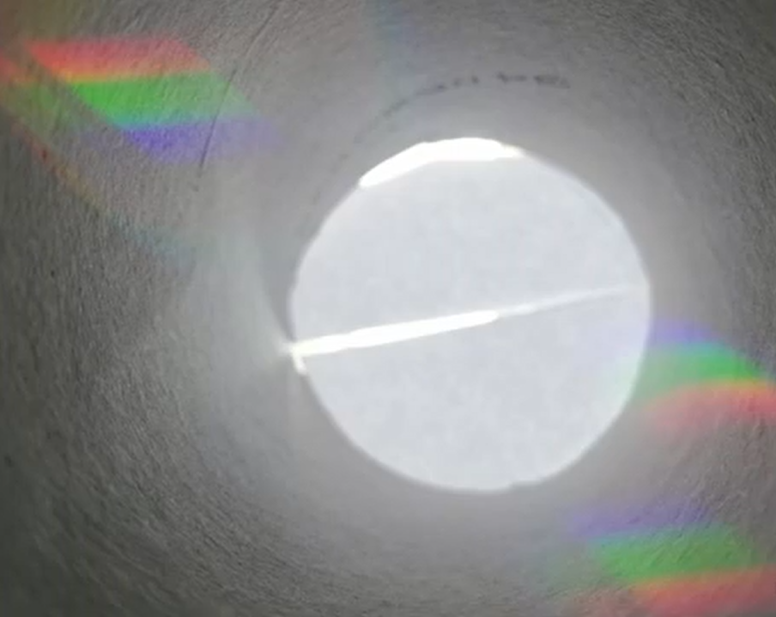
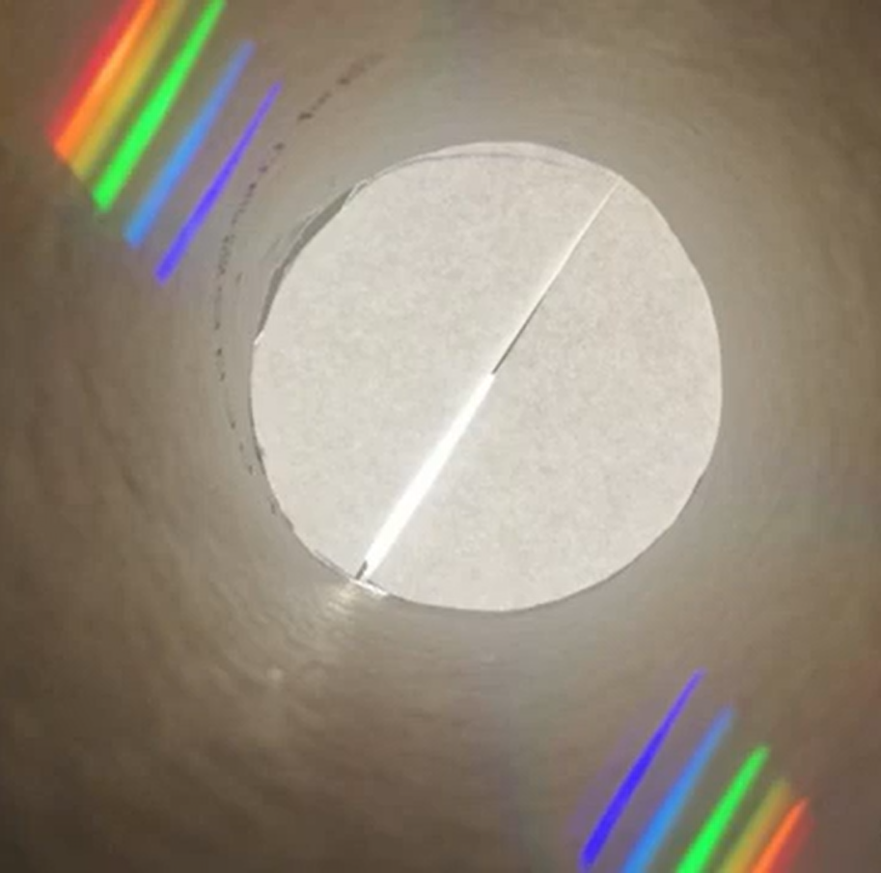
Notes:
Spectroscope, natural light (left) versus artificial light (right)

Slide 19
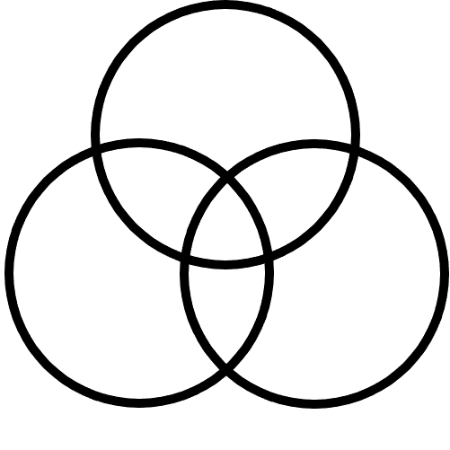
Paint
Light

Slide 20
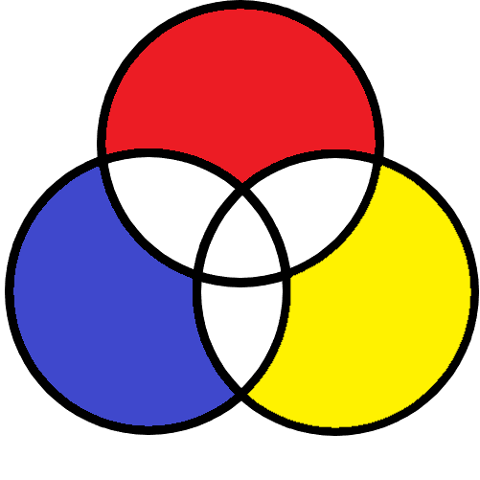
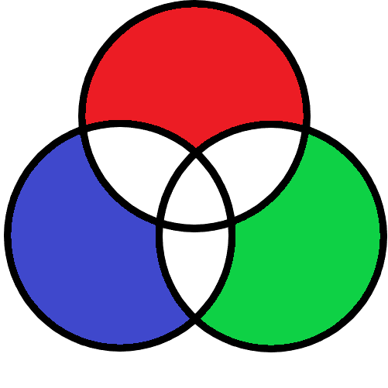
Paint
Light
?
?
?
?
?
?
?
?
Notes:
Fill in the three primary colours of paint, and the three primary colours of light.

Slide 21
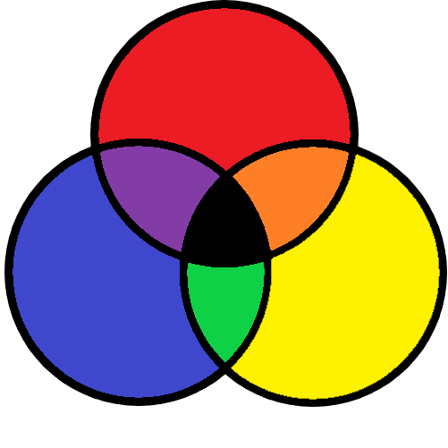
Paint
Light
?
?
?
?
Notes:
What happens when you mix two or more colours of paint?
Use knowledge from art and paint mixing to fill in the secondary colours of paint.
Now we will experiment and explore with the spectroscope to determine the secondary colours of light.

Slide 22


Slide 30
Paint
Light
?
?
?
?
Notes:
From what you have seen with your spectroscope, fill in the secondary colours of light.

Slide 31
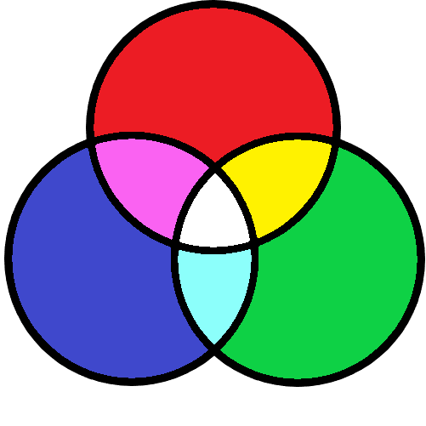
Paint
Light

Slide 32
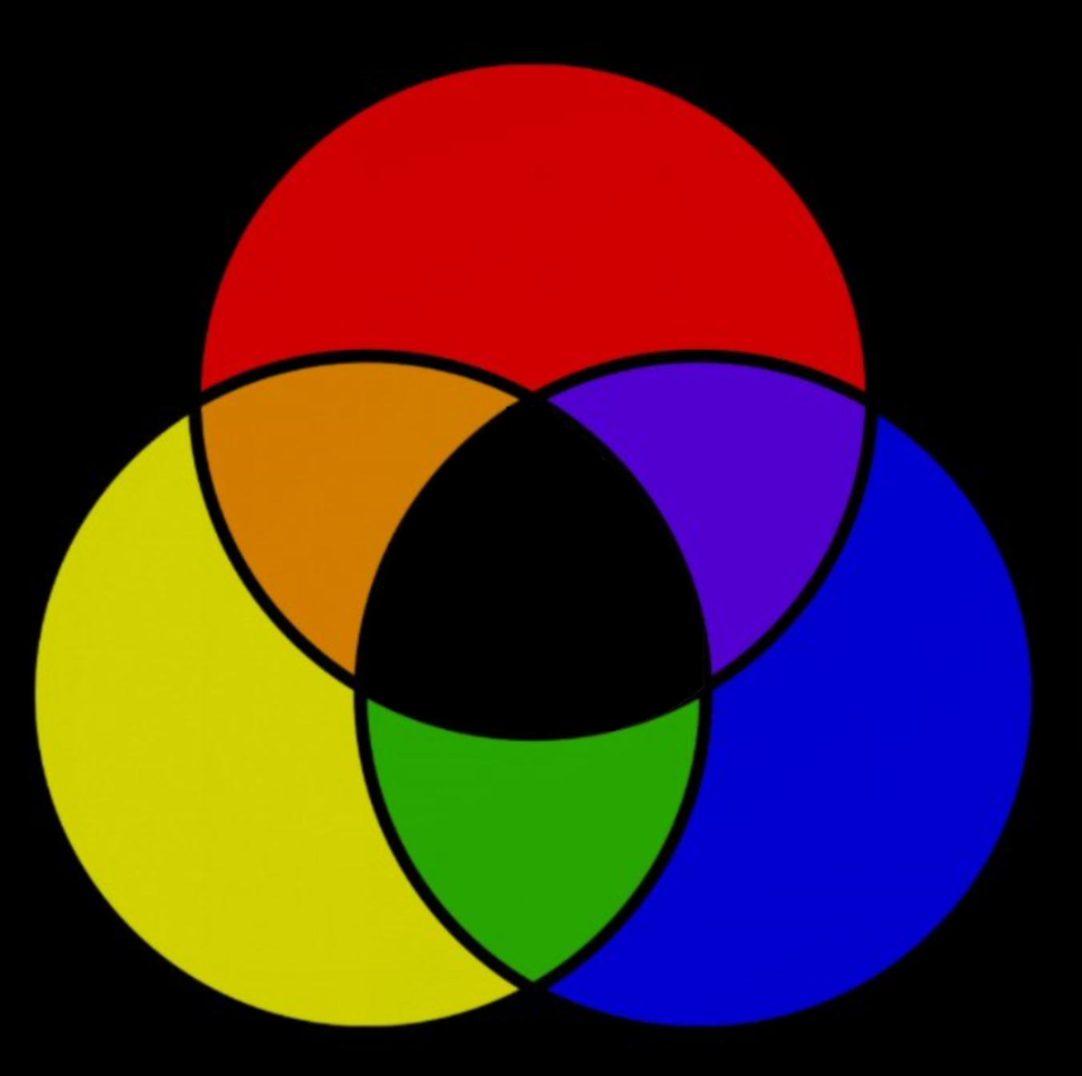
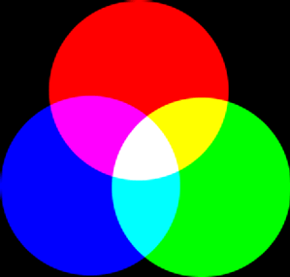

Slide 33
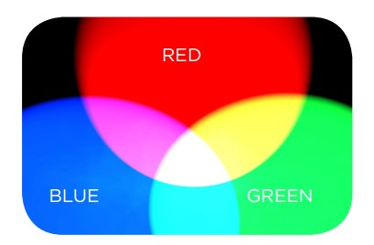
Notes:
Combining light

Slide 34
Combining Light
Notes:
If we can split white light into all the different colours, can we create white light by combining colours?
What might we need?
Can we make different colours of light starting with 3 basics?

Slide 35
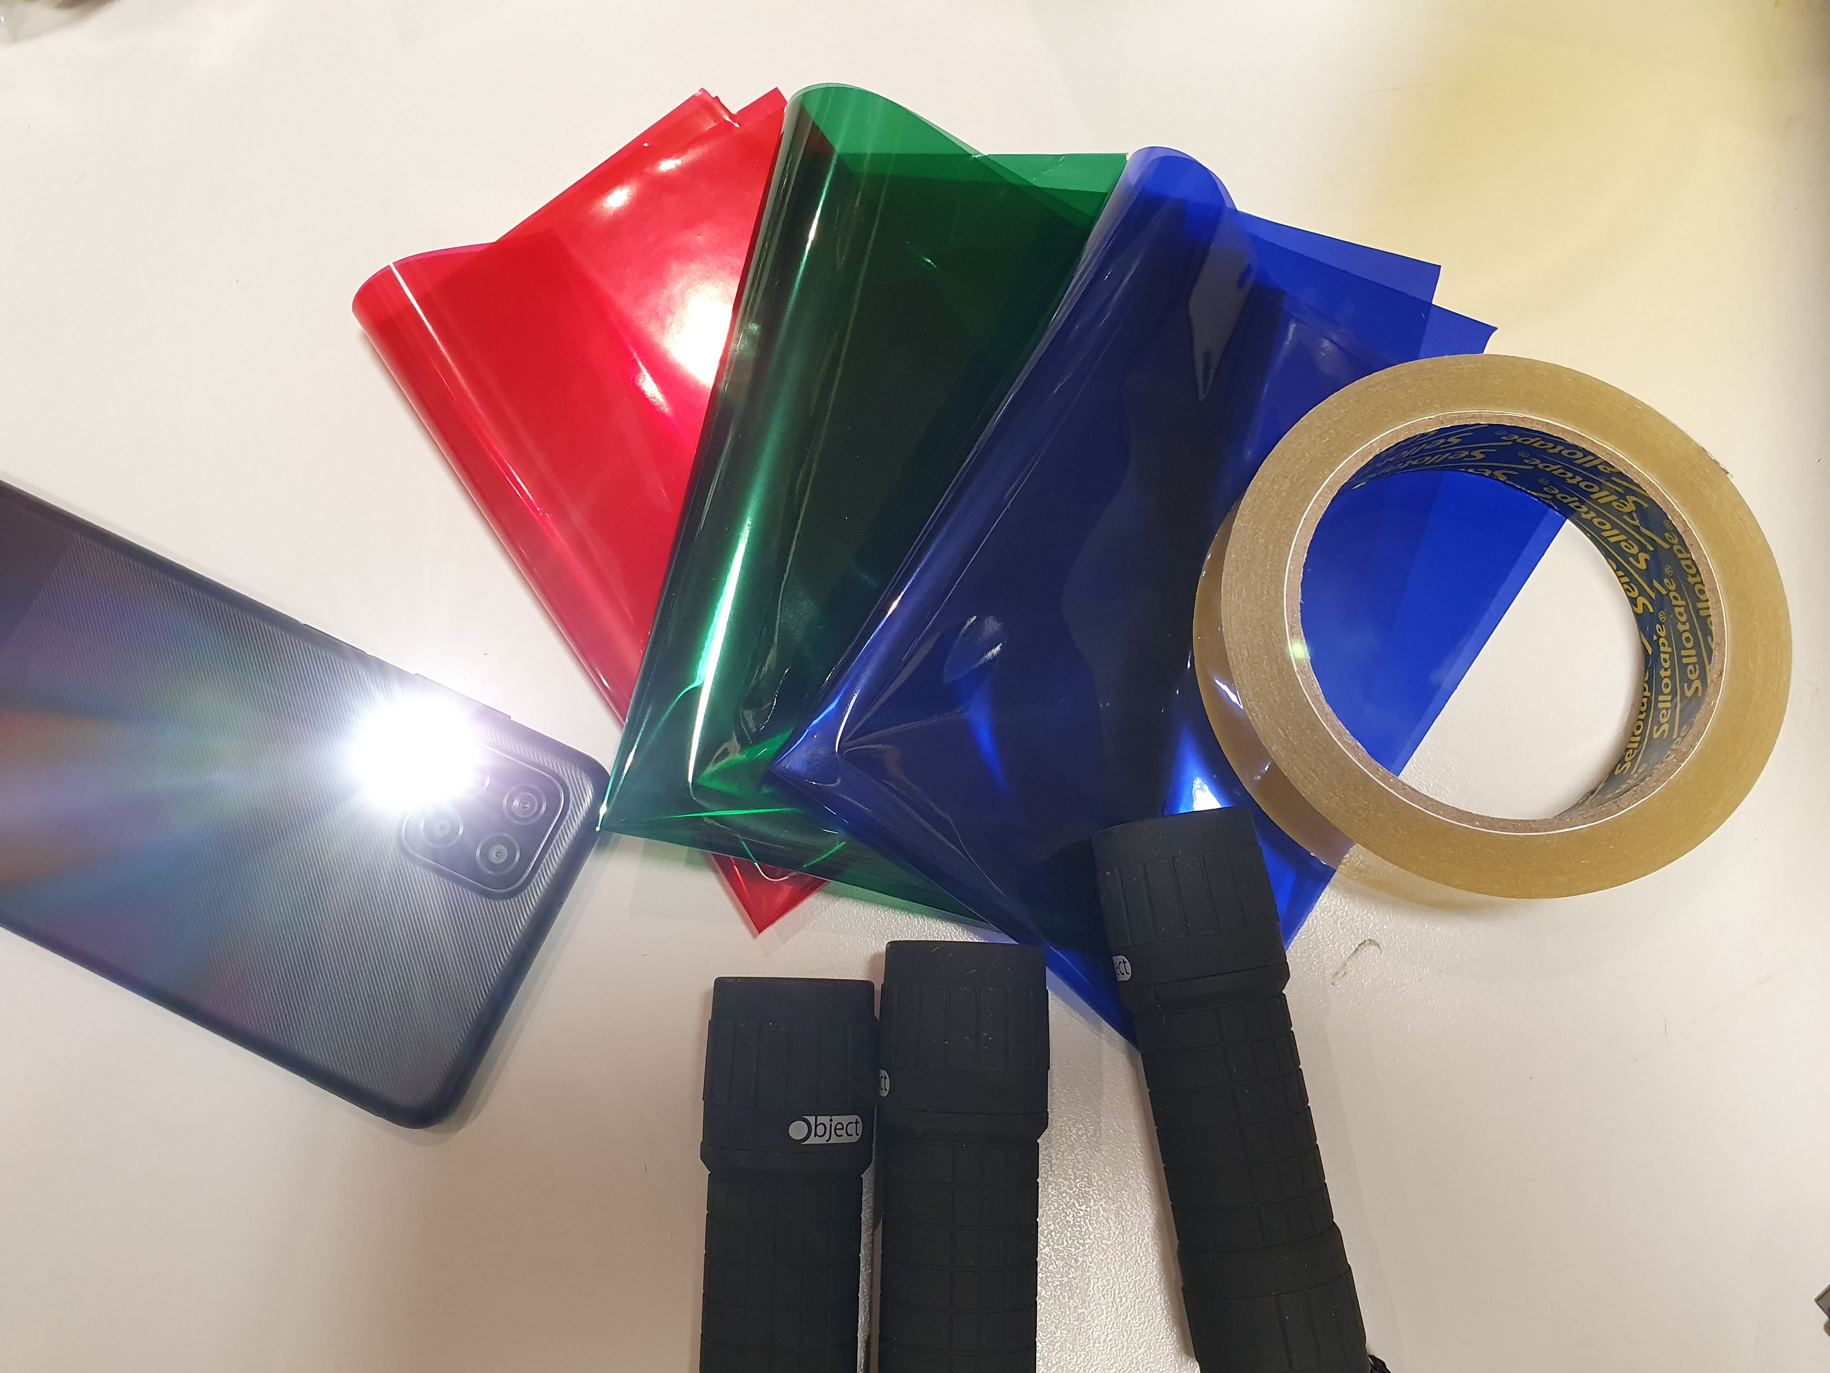
include images of materials and setup
Notes:
Gather your materials.
Example of activity: Coloured Shadows - Science World

Slide 36
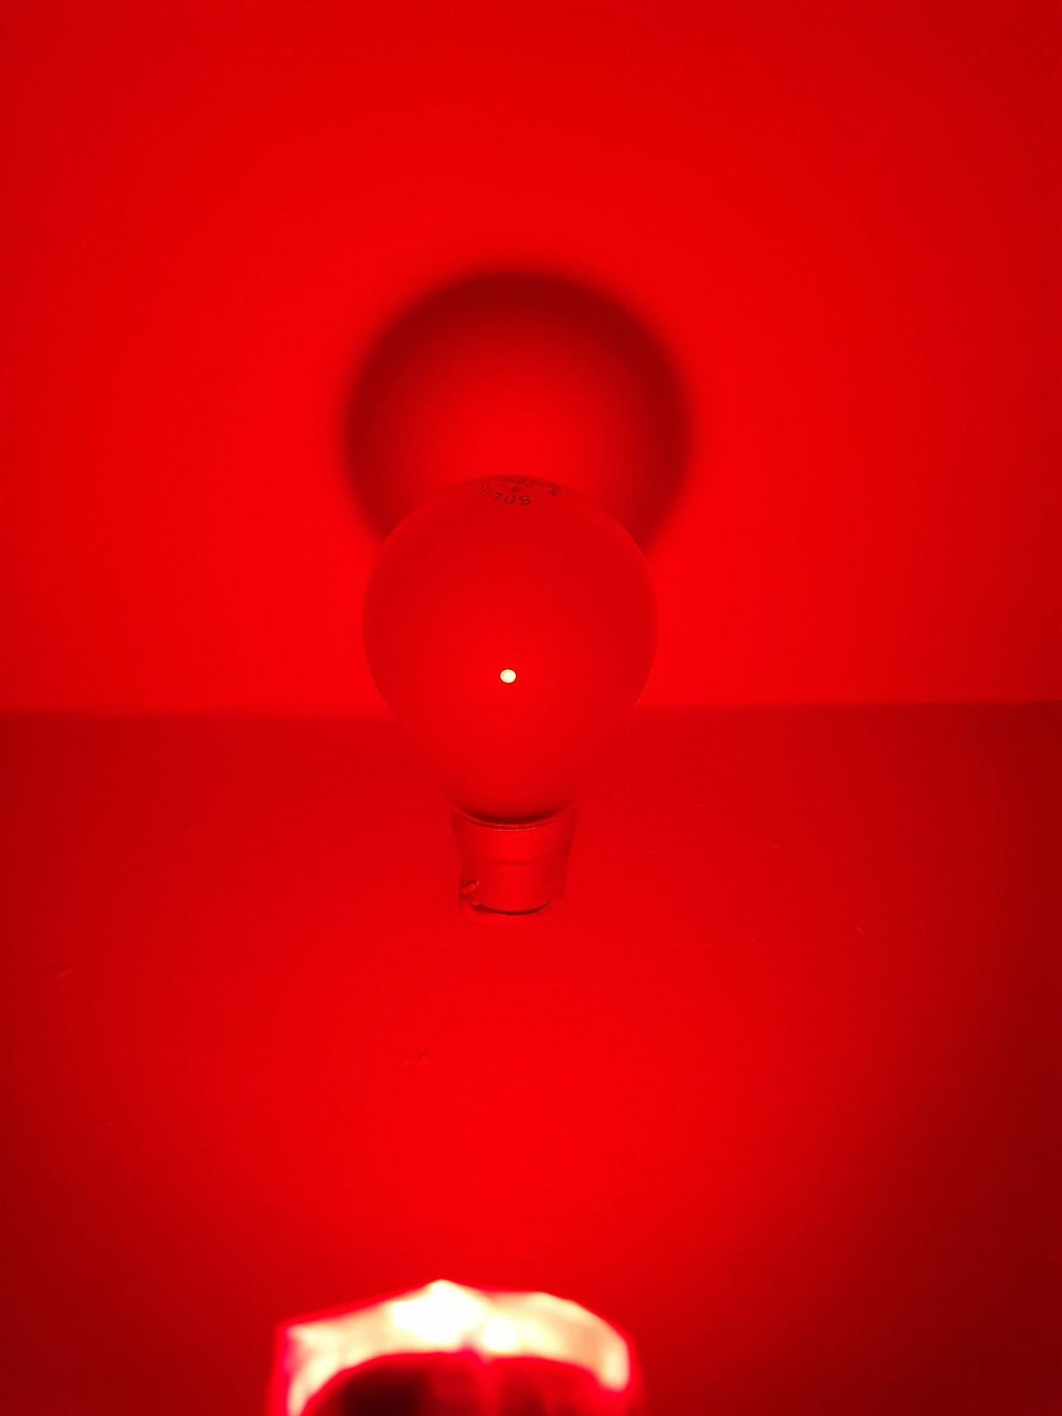
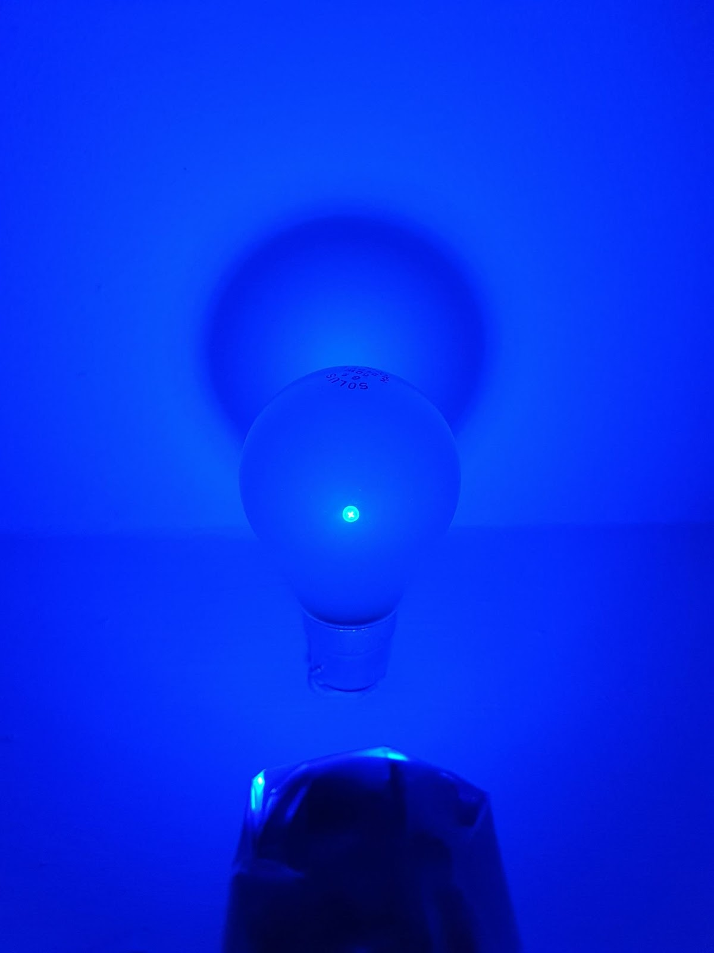
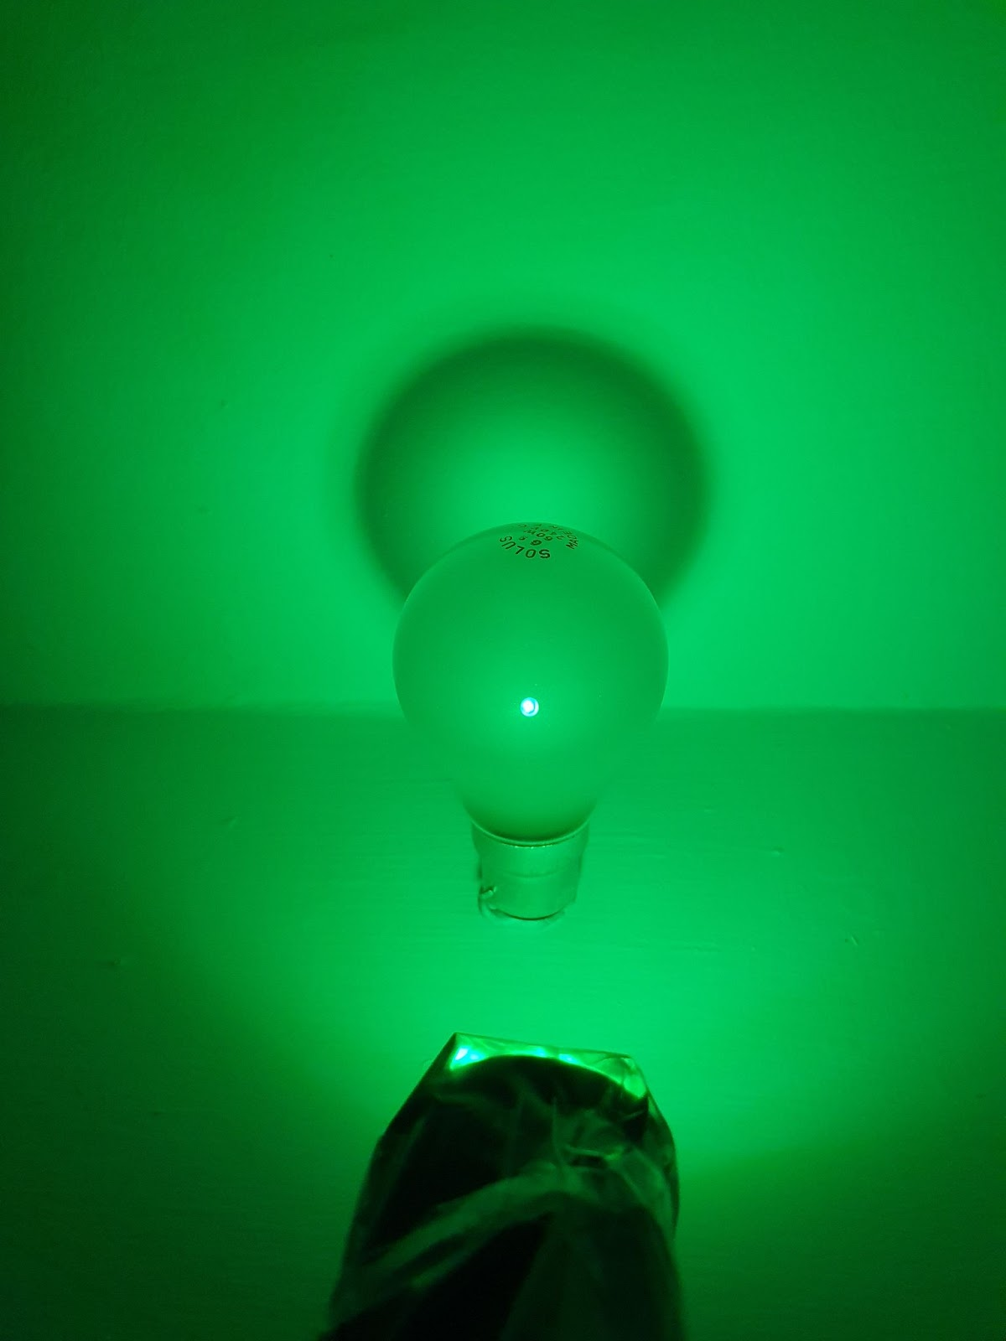
Notes:
If we can split white light into all the different colours, can we create white light by combining colours?
What might we need?
Can we make different colours of light starting with 3 basics?

Slide 37
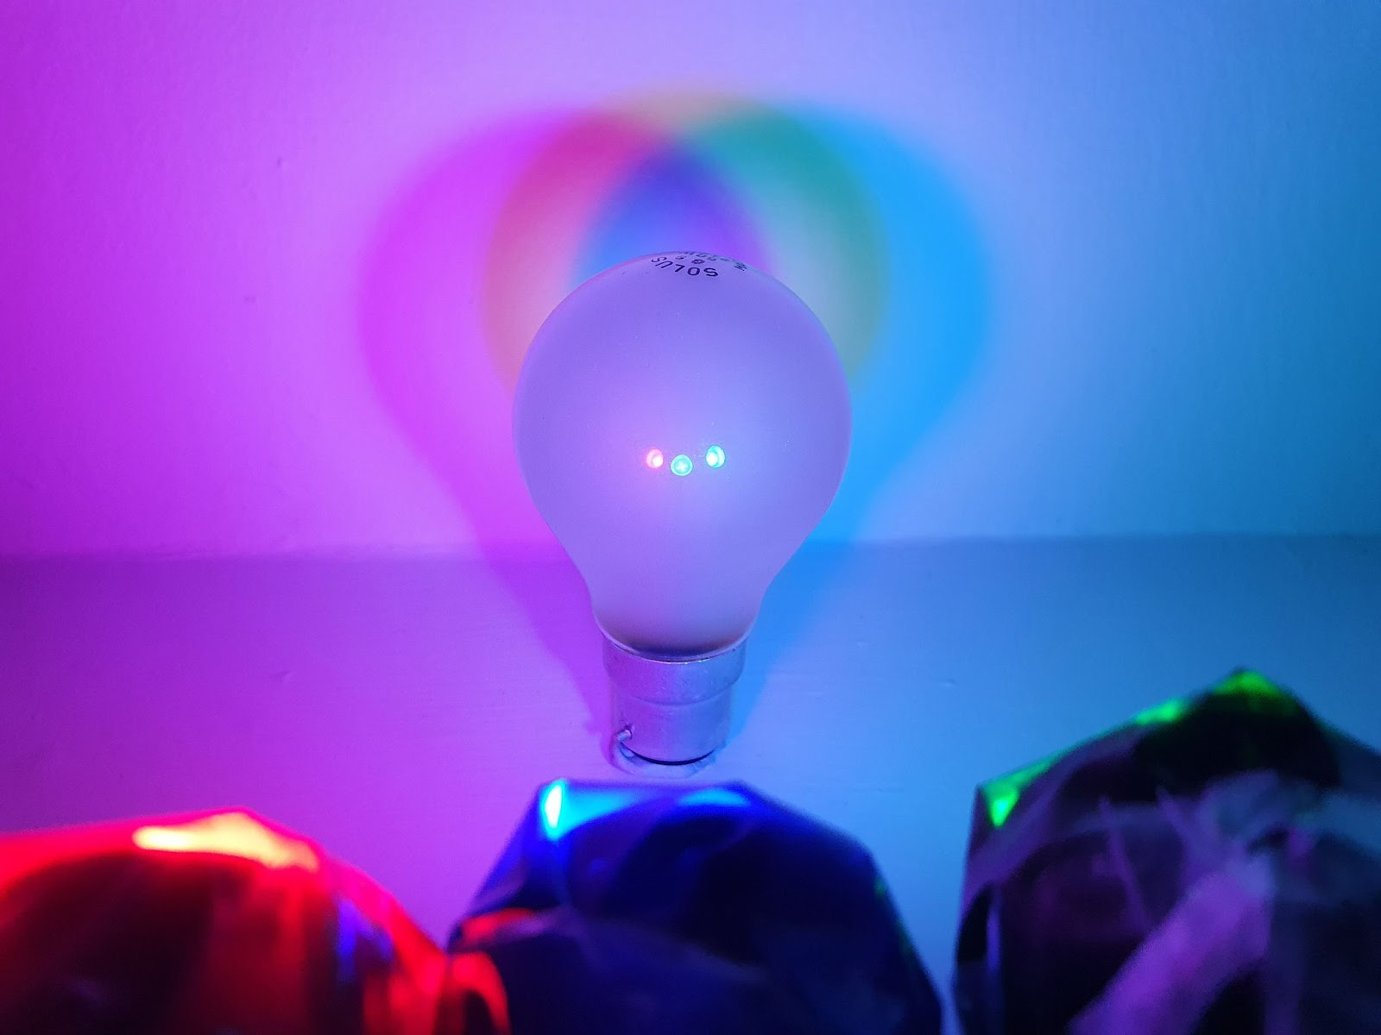
What colours do you see?
What will happen if we take away one of the torches?
include images of materials and setup
Notes:
Coloured Shadows - Science World

Slide 38
Is there anywhere you see this happening everyday?

Slide 39
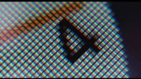
On screens!
Red, Green and Blue (RGB) pixels mix
to give different colours…
https://youtu.be/O9AH7nd9p14
Notes:
Link to video on YouTube: iPhone Clock icon pixels on microscope (zoom x200) – YouTube (https://www.youtube.com/watch?v=O9AH7nd9p14&ab_channel=NicolasV08

Slide 40
Probing questions
What did you learn about how light travels?
Were you familiar with the colours/colour combinations of light?
Is it different to what you thought or expected?
Can you think of other everyday examples where we see this which are relevant to you?
Can you think of other ways to use this, splitting or combining light?

