Slide 1

Sustainable Development Goals and YOUth

Slide 2

Hello!
We are the first generation that can end poverty, and the last one that can take steps to avoid the worst impacts of climate change. With the adoption of a new development agenda, sustainable development goals and climate change agreement, we can set the world on course for a better future. This must be a time for global action. Future generations will judge us harshly if we fail to meet our obligation – Ban Ki-moon
SDGs: A new blueprint for the world

Slide 3


Big
concept
Local
Not really….
Global

Slide 4
Sustainable Development Goals (SDGs)
17 goals which World Leaders have signed up to
Agenda 2030 – will last for 15 years from 2015 - 2030
5 P’s – People; Planet; Prosperity; Peace; and Partnership.
6th P - Participation
No one should get left behind

Slide 5
SDGs
Poverty; Hunger; Agriculture; Health & Well-Being; Education; Gender Equality; Water; Economic Growth; Employment; Infrastructure; Innovation; Energy; Inequality; Cities; Consumption; Climate Change; Oceans; Forests; Peace; Justice; Partnership and more…
What issues are involved with the SDGs?
Every country to develop a National Action Plan!!!

Slide 6
Applies to ALL countries
The SDGs are UNIVERSAL… meaning that it is about what happens in Ireland AND what happens throughout the world…linking the local to the global

Slide 7
It’s about Development which
is a process that enables human beings to realise their full potential, build self confidence and lead lives of dignity and fulfilment
is a process which frees people from fear of want and exploitation, with a move towards a more decent, sustainable standard of living for people and planet
meets the needs of the present generation without compromising the ability of future generations to meet their needs
looks to balance different and often competing needs against an awareness of the environmental, social, political and economic limitations

Slide 8
Development…
People are able to participate in the life of the community
Fairer distribution of wealth
Increased political and environmental stability
Sustainable economic growth
Healthier, happier life for everyone
Less dependence by one nation on another
Provision of basic needs for all
Increased interdependence between nations
Should leave no one behind

Slide 9
Why should we care?
There are 7 billion+ people alive today on the planet
We need to know our local, national, and global neighbours by exploring cultural, environmental, economic, political, and social relationships and to challenge local and global power inequalities
1 billion control over 80% of resources
Population in developing countries is growing much faster
Youth work approach fits – preparing young people for the world they live in - good youth work
Ensure outcomes for young people in National Youth Strategy are met

Slide 10
Why should we care?
There are 1.8 billion young people aged 10-24 living today – largest in history
Close to 90% of the world’s young people live in developing countries
More than 500 million young people aged 15-24 live on less than $2 a day
Approx 74 million young people are unemployed, and more than 600 million jobs are needed by 2030
We should know and understand the causes and consequences of some of the world’s major challenges – global hunger, poverty, injustice, inequality and climate change

Slide 11
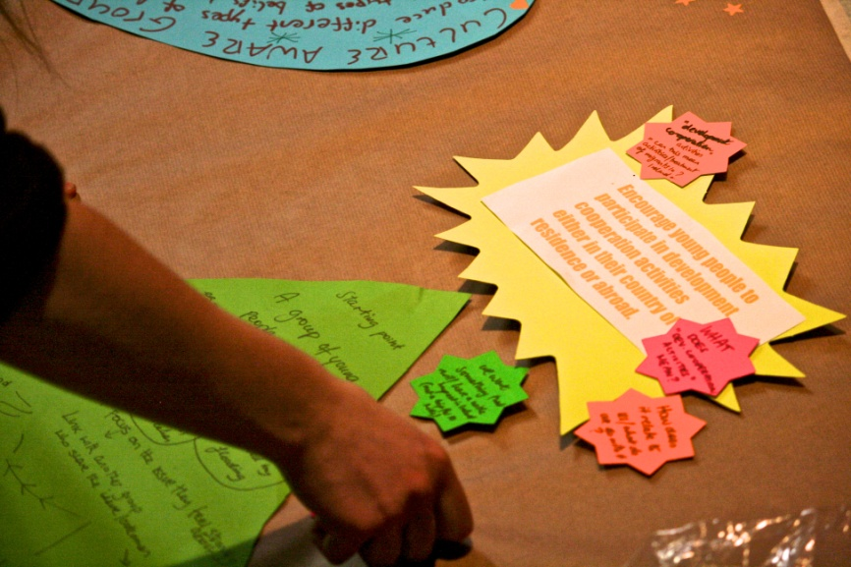
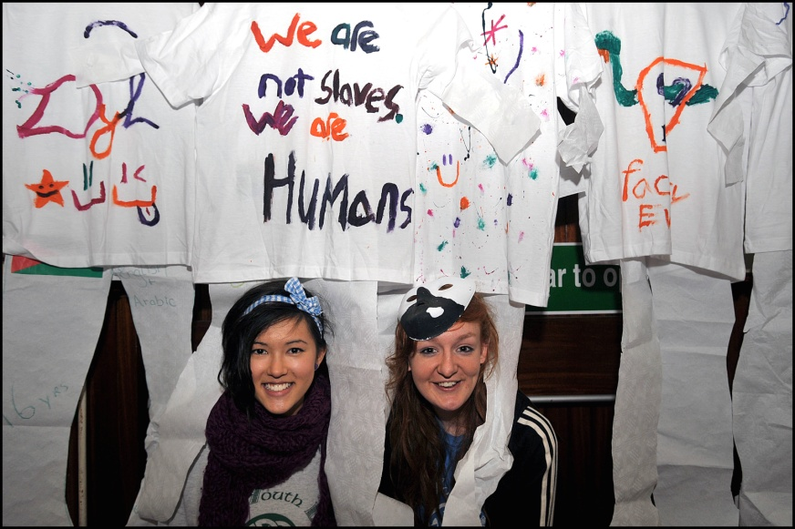
Development Education
Development Education in the Youth Sector aims to support young people to increase their awareness and understanding of the interdependent and unequal world in which we live, through a process of
interactive learning, critical thinking, debate, action and reflection.
It challenges perceptions of the world and encourages young people to act for a more just and equal society at
a local, national and an international level

Slide 12
Development
Education
Values
Equality, Justice, Diversity, Solidarity, Sustainability, Interdependence, Community, Human Rights & Responsibilities, Participation & Action

Slide 13
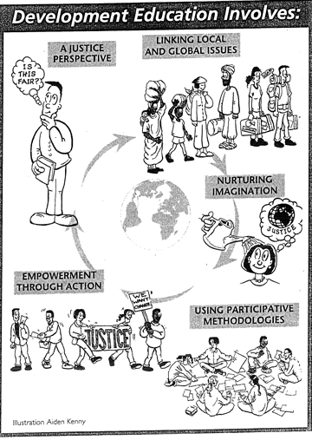

Development Education & the SDGs involves…

Slide 14
SDGs & Young People
Start where young people are at
Make Global Connections
Highlight equality, diversity & justice issues locally and globally
Encourage young people to imagine a better world
5. Support young people to
take action for global
change
6. Learn from your
experiences
7. Learn from others’
experiences
8. Make development
education & SDGs an on-
going part of your work

Slide 15
What do we want?
End Extreme Poverty
Fight Inequality
Address Climate Change

Slide 17
Sustainable Development Goals – 17 goals
  Goal 1: End poverty in all its forms everywhere
  Goal 2: End hunger, achieve food security and improved nutrition, and promote sustainable agriculture
  Goal 3:Ensure healthy lives and promote wellbeing for all at all ages
  Goal 4: Ensure inclusive and equitable quality education and promote lifelong learning opportunities for all
  Goal 5:Achieve gender equality and empower all women and girls
  Goal 6: Ensure availability and sustainable management of water and sanitation for all
  Goal 7: Ensure access to affordable, reliable, sustainable and modern energy for all
  Goal 8: Promote sustained, inclusive and sustainable economic growth, full and productive employment, and decent work for all
  Goal 9: Build resilient infrastructure, promote inclusive and sustainable industrialisation, and foster innovation
  Goal 10: Reduce inequality within and among countries
  Goal 11: Make cities and human settlements inclusive, safe, resilient and sustainable
  Goal 12: Ensure sustainable consumption and production patterns
  Goal 13: Take urgent action to combat climate change and its impacts
  Goal 14: Conserve and sustainably use the oceans, seas and marine resources for sustainable development
  Goal 15: Protect, restore and promote sustainable use of terrestrial ecosystems, sustainably manage forests, combat desertification and halt and reverse land degradation, and halt biodiversity loss
  Goal 16: Promote peaceful and inclusive societies for sustainable development, provide access to justice for all and build effective, accountable and inclusive institutions at all levels
  Goal 17: Strengthen the means of implementation and revitalise the global partnership for sustainable development

Slide 18
Linking SDGs, Development Education, and Youth Work…

Slide 19
The Purpose of Youth Work
To build young people’s self-esteem and self-confidence
To develop their ability to manage personal and social relationships
To offer worthwhile and challenging new experiences
To provide learning opportunities to enable young people to gain knowledge and develop new skills
To build young people’s capacity to consider risks and consequences and make informed decisions and take responsibility
To help young people to develop social awareness and a sense of social solidarity
To give young people a voice in decision-making which affects their lives
To enhance young people’s role as active citizens
To listen to and hear what young people have to say

Slide 20
Values of Youth Work
The values of youth work match the purpose of education and are fundamental to the process, raising the confidence of individuals, their contribution to society, and their value as citizens. These values are:
Empowerment of young people
Equality and inclusion
Respect for all young people
Involvement of young people in decision-making
Partnership
Voluntary participation

Slide 21
Youth Work and DE Skills
Employability Skills
Teamwork
Research
Confidence
Taking informed action
Communication
Open-mindedness to diversity
Cooperation
Resilience and determination
Leadership
Positive relationships
Decision making
Self esteem and sense of self
Networking
Creativity and imagination
Critical understanding
Planning and problem solving
Emotional Intelligence
(Including 7 Potent Mechanisms – delivering improvements to targeted youth Programmes - DCYA: Value for Money)
Leadership (57%)
People management and teamwork (51%)
Innovation and entrepreneurship (50%)
Communication (39%)
Adaptability and flexibility (39%)
Change management (35%)
Project management (19%)
Decision making (17%)
Time management (14%)
Accenture – Closing the Skills Gap in Ireland (2013) Survey of 100 employers

Slide 22
DE has 4 key elements
Skills and Capabilities
Skills that help us understand and engage with our world - analytical and communication skills, interpersonal and social skills, the ability to link knowledge and understanding with action etc.
Behaviour, Experiences and Action
Social relationships, personal behaviour, opportunities to participate meaningfully, competence at carrying out tasks, fulfilling potential, linking ideas, action and behaviour.
Attitudes and values
About oneself and others, about social responsibilities, respect, about learning, behaviour, beliefs, subject knowledge and about society here in Ireland and internationally.
Knowledge and Understanding
Factual information about the shape of our world, ideas about why it is shaped the way it is (gender, sustainable development, citizenship etc), about connections between wealth and poverty, progress and inequality, about relationships locally and internationally etc.

Slide 23
Development Education in the youth sector is unique because...
Young people participate on a voluntary basis
There is a great diversity of organisations/groups working within the youth sector reflecting the diversity of interests of young people
The methods and approaches allow young people and particularly marginalised young people to access DE and to have their voices heard
Organisations within the sector who are experts in both DE/ ESD and Youth work
Starts where ‘young people are at’ adopting a flexible & creative approach
Pays attention to process and outcomes
Provides quality opportunities to engage with DE
Young people are active partners in making decisions, planning programmes, setting priorities
Our relationships are based on dialogue and partnership between young people and adults
Engage in a reflective learning process through an ongoing cycle of experience, observation, reflection and action
Youth work aims to eradicate injustice and inequality and strives for openness and inclusiveness in all its dealings with young people and adults locally, nationally and internationally

Slide 24
What we do
Introduce human development and developing world perspectives to young people
Create opportunities where the knowledge, values, attitudes and skills related to DE are explored in a holistic and engaging process
Provide educational opportunities to empower young people to take action on DE issues by building self confidence and developing skills such as critical thinking, systems analysis, futures thinking
Build young people’s capacity to consider risks and consequences; make informed decisions and take responsibility, globally and locally
Support young people to develop social, environmental and global awareness and a sense of solidarity
Give young people a voice in decision-making which affects their lives
Enhance young people’s role as active global citizens
Listen to and hear what young people have to say
Work collaboratively within the sector and across sectors to achieve better outcomes for young people
Build capacity of educators to deliver DE
Build competency through research, educational materials, training, opportunities
Build on key DE activities and events in the youth sector

Slide 25
DE/SDGs local/global justice issues
DEBT
HUNGER
CLIMATE JUSTICE
GLOBALISATION
HUMAN RIGHTS
GENDER
POVERTY
HEALTH
EDUCATION
FAIR TRADE
ENVIRONMENT
DRUGS
DEMOCRACY
CLIMATE CHANGE
MIGRATION
JUSTICE
EMPLOYMENT
VOLUNTEERING
VIOLENCE
CONSUMPTION
HIV & AIDS
PEACE & CONFLICT
AID
WATER
CHILD LABOUR
DISCRIMINATION

Slide 26
National Youth Strategy
5.1 Implement Participation Strategy
5.2 Support young people’s
involvement in Comhairle, EU
Structured Dialogue, and other
participation initiatives
5.4 Promote social entrepreneurship
and active citizenship
5.5 Increase young people’s political
engagement
5.9 Forum of interests to support,
through cross-sectoral collaboration,
implementation of SDGs, ESD
Strategy, and Irish Aid DE Strategy
5.11Promote volunteering opportunities
including UN Youth Delegates
Outcome 5:
Connected, respected & contributing to their world
Objectives:
9. Young people are included in society, environmentally aware, their equality and rights upheld, their diversity celebrated and are empowered to be active global citizens
10. Young people’s autonomy is supported, their active citizenship fostered, and their voice strengthened through political, social and civic engagement

Slide 27
NQSF & Development Education
Surveys on young people’s interests/concerns, identifying local/global connections; Programme based on local/global issues/concerns; Global perspectives through music, sport, drama, cartoons, art, programmes, etc.
DE supports knowledge about global issues including health, trade, education, work, drugs, justice, environment, etc. Explore our own identity and place in the local, national and global community.
Young person-centred (1)
Education and developmental (3)
Equality and Inclusiveness (4)
Quality youth work and continuous improvement (5)
A DE policy/approach critically accesses engagement with people from developing countries and from minority ethnic backgrounds, bringing different perspectives & promoting respect, solidarity, volunteerism, interdependence, equality & justice.
Critical reflection and questioning of our world is fundamental to DE. How we manage youth work settings, inclusive & collaborative programmes, local/global focus. DE & youth work commitment to quality & good practice.

Slide 28
Learning in a Global Society
Identify common interests and develop solidarity with diverse communities
Combat racism
Widen horizons and personal development
Make a difference to their world by participating in society
Understand their own situation in a wider context
Make connections between local and global events
Develop skills and knowledge to interpret events affecting their lives
Understand causes of global inequality, justice and solidarity
Learning from experiences elsewhere in the world
-

Slide 29
Five Faces of Globalisation & PLiNGs
Dr. Momodou Sallah
cultural
political
Personal
Local
National
Global
PLiNGS
Young People
PLiNGS
PLiNGS
PLiNGS
environmental
economic
PLiNGS
technological

Slide 30
Other things to take into account when considering Development Education, Youth Work, and the SDGs…

Slide 31
7 Potent Mechanisms
Delivering improvements for targeted youth programmes (Value for Money Report)
Communication skills essential for successful transition to work or training, for independence, and to access a range of
life opportunities, to attainment, in forming positive relationships and in reductions in re-offending
Confidence & agency enables young people to recognise they can make a difference & effort has a purpose, is important to key outcomes such as career success. Evidence of link between positive outcomes & self-confidence
Planning and problem-solving, alongside resilience, provides young people with a ‘positive protective armour’ against negative outcomes associated with risky life events. Problem solving has shown to be associated with the ability to cope with stresses in life
Relationships an effective mechanism for getting young people involved in positive activities through valued personal relationships with peers, adults or siblings. A beneficial change in young people’s relationships with other adults through their participation in positive activities can be transferred to academic learning and may lead to better outcomes
Creativity and imagination is related to resilience and well-being. Creativity can have a positive impact on both self-esteem and overall achievement
Resilience and determination – If society intervenes early enough, it can improve cognitive and socio-emotional abilities and the health of disadvantaged children. Effective early interventions can promote schooling, reduce crime, foster workforce productivity and reduce teenage pregnancy. Self-discipline has been highlighted as a vital factor in building academic achievement, significantly better than IQ
Emotional intelligence is associated with the ability to manage feelings by knowing one’s own emotions, as well as recognising and understanding other people’s emotions. This is vital in managing relationships (e.g. managing the emotions of others)

Slide 32
Youth Participation Charter Principles
Voluntary Youth participation must be, in essence, a voluntary arrangement if it is to be of any value to the young people involved | Resourced Activities and initiatives also need to be adequately resourced in terms of staff support, access to information, funding, time span and space to carry out activities
Informed Young people should be made aware of what they are getting involved in and what their rights and responsibilities are | Valued Young people should feel that they are valued and are being taken seriously, as is their work, in order to avoid tokenism
Relevant Young people should be able to input into the development of initiatives which should aim to address their needs and deal with relevant issues of importance to them | Owned Activities and initiatives should be youth led and young people involved should feel that they have ownership
Enjoyable Young people need to have fun and feel valued, therefore, all youth participation initiatives, no mater how intense, need to be implemented in a way that is enjoyable | Flexible In order to meet the changing needs of young people and allow for personal and other work obligations, there needs to be a certain amount of flexibility built into youth participation initiatives
Developmental Young people should be given the opportunity to explore issues relating to the society in which they live and be empowered to become active citizens | Diverse It is important that all young people are afforded the opportunity to participate and that diversity in groups is not only respected, but sought after
Educational Youth participation projects should provide young people with opportunities for learning in both formal and informal settings | Monitored and evaluated In order to ensure that initiatives are meeting the changing needs of the young people involved and to promote innovative youth participation activities, it is vital that all such initiatives and activities are monitored and evaluated on an ongoing basis
Supported Youth participation initiatives and activities should be supported as appropriate, whether that involves training, advice, or guidance | http://www.youth.ie/nyci/why-dont-we-youth-participation-resource-pack

Slide 33






THANKS!
Any questions?
You can find me Valerie Duffy
at @nycinews & deved@nyci.ie
http://www.oneworldweek.ie/sites/default/files/SDGs_Youth_Resource%20_Pack.pdf
www.facebook.com/NationalYouthCouncil
www.oneworldweek.ie
www.youthdeved.ie
Place your screenshot here

